Slide 1

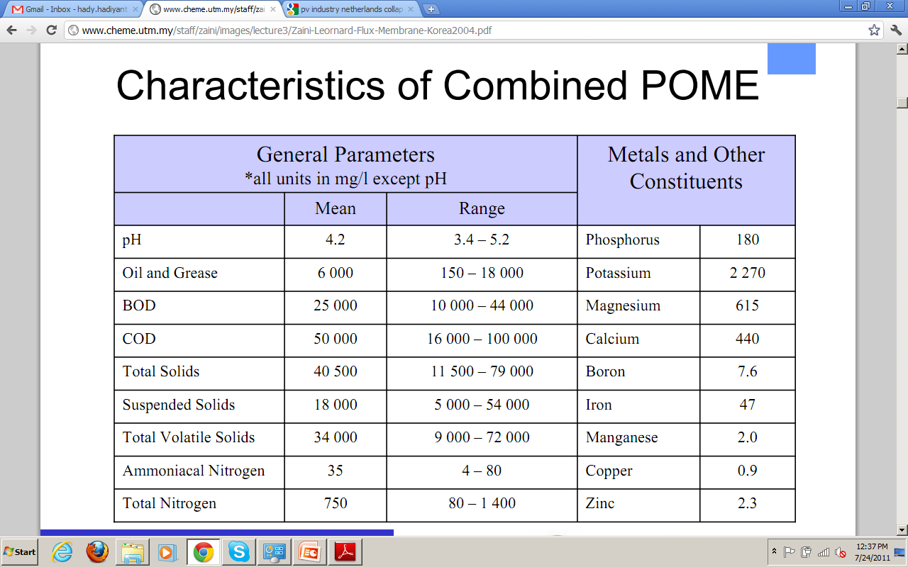
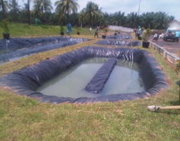
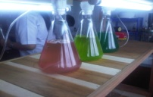
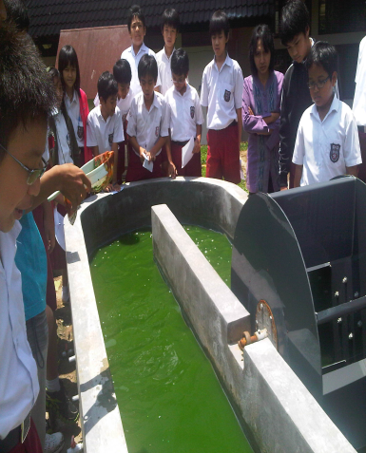
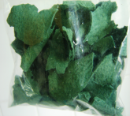
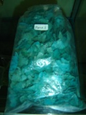
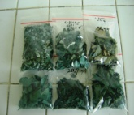
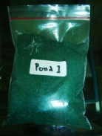
WASTE TO BIOENERGY AND FEED
Utilization Of POME (Palm Oil Mill Effluent) for Biofuel and Protein Productions
HADIYANTO
Center for Biomass and Renewable Energy (C-BIORE) Chemical Engineering Department, Diponegoro University
Jl. Prof. Soedarto, SH Tembalang Semarang – 50239, Email: hady.hadiyanto@gmail.com
http://biore.coe.undip.ac.id
Introduction
Table 1. POME characteristic
The Indonesian palm oil industry has grown rapidly over the past few years and becomes the world's largest producer of crude palm oil. However, this large production produces enormous amount of Palm Oil Mill Effluent (POME) which is about 0.6 ton POME/tone FFB. The main problem of this waste is high level of COD/BOD, and total solid (Table 1) that may be harmful for environment. In other hand, nutrient contents such as N, P, K seem to be potential advantages of POME especially for cultivation media of algae to produce biomass through photosynthesis reaction. The biomass then can be transformed to biofuel and feed due to their composition which is rich of lipid and protein. Therefore the aim of this project is to utilize POME for food and energy by the help of microalgae.
Biogas
The Proposed Concept
POME
The concept of valorization is described by Figure 1. Due to high content of COD, POME is utilized to produce biogas through anaerobic fermentation. It is estimated that 1 ton of POME can produce 15-20 m3 biogas with caloric value of 15-20 MJ/m3 biogas.
The digested POME containing high nutrition is fed into algae pond for biomass production. High content of N,P and K will be advantage for algae growth and photosynthetic. The carbon sources will be provided by using biogas from biodigester. It is well known that biogas contains of 30-40% CO2.
Biodigester
CO2
N,P,K
Algae
POND
Protein
Spirulina Products
Sample | Protein (%) | Lipid (%) | Fiber (%) | Ash (%) | Water (%)
With Pome | 54,86 | 0,3868 | 32.6490 | 10.3971 | 16.7039
Fresh water | 58.71 | 0.0856 | 36.2861 | 8.9864 | 14.3855
The current Spirulina product is eligible for feed supplements

